Slide 1



AutoAdvisor - Simple AI Chatbot for the Automobile Industry
Team AIRational
Aarya Hari
Jasmit Singh Gill
Mehul Paithane
Penchala Mullupati
Rutuja Samant
Sahat Shah
Sumedh Tirodkar

Slide 2







MEET THE TEAM
Aarya Hari
Jasmit Singh Gill
Mehul Paithane
Sahat Shah
Penchala Mullupati
Rutuja Samant
Sumedh Tirodkar

Slide 3
TABLE OF CONTENTS
01
02
03
04
05
06
07
Introduction
Business Case
Challenges
OpenAI Model Training
Use Cases
Next Steps and Lessons Learned
Conclusion

Slide 4


01
INTRODUCTION

Slide 5
Impact :
Consumers will experience reduced frustration.
Businesses stand to benefit from increased customer satisfaction and improved efficiency in handling inquiries.
Business Problem:
Car buying process is overwhelming, leading to dissatisfaction and confusion.
AI Solution:
AutoAdvisor provides personalized recommendations and guidance to buyers.

Slide 6
02
BUSINESS CASE

Slide 7
BUSINESS CASE
Satisfaction rate of new and used car buyers has been on a decline.
Potential reasons are:
COMPLEXITY
ASSISTANCE GAP
TECH INTEGRATION

Slide 8
First Time Car Buyers:
Challenges Faced: Overwhelmed by options and lacking industry knowledge.
Solution: Guided exploration of vehicle types, features, and financing options.
Outcome: Simplified decision making, increased confidence in purchase.
Busy Professionals:
Challenges Faced: Limited time for dealership visits and research.
Solution: Quick, efficient communication for vehicle selection and transaction processing.
Outcome: Timesaving and convenient car buying experience.
Vehicle Upgrade Seekers:
Challenges Faced: Seeking the best value upgrade based on current trends.
Solution: Comparative insights and recommendations on newer models.
Outcome: Informed upgrading, ensuring best value and satisfaction.

Slide 9
03
CHALLENGES

Slide 10
Satisfaction rate of new and used car buyers has been on a decline
Challenges Include
Information Overload
Financial Considerations
Technical Specifications

Slide 11
04
OPENAI MODEL TRAINING - CODE

Slide 12
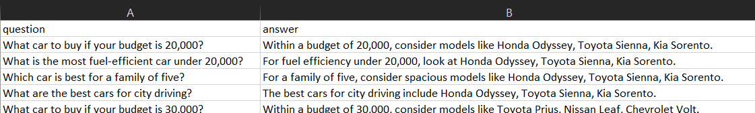
DATASET & MODEL TRAINING
The dataset is a CSV file in a textual format that contains information about which car to buy in what scenario
It has around 10,000 rors and 2 columns in it - question and Answer format.
We use only 100 rows for training and the next 100 for validation due to time constraints.
For fine-tuning, we use GPT 3.5 Turbo, which is an excellent model selection.
100 rows are used to test this model and generate results.

Slide 13
CODE DEMONSTRATION

Slide 14
05
USE CASES

Slide 15
Personalized Recommendations
Utilizes advanced algorithms to suggest vehicles based on user inputs like budget and preferences.
Tailored approach enhances customer satisfaction and trust.
Cost Effectiveness
Automates initial customer interactions, reducing the need for a large sales force.
Handles multiple inquiries simultaneously, scaling customer interaction without increasing costs.
Reduction in Purchase Anxiety
Provides detailed information and real time query responses.
Offers comparisons and detailed feedback using unbiased data to ease decision making.
Enhanced User Engagement
Delivers a responsive, interactive experience.
Provides multimedia content and virtual car tours to maintain interest and guide purchase decisions.

Slide 16
06
NEXT STEPS AND LESSONS LEARNED

Slide 17
NEXT STEPS AND LESSONS LEARNED
Enhance the model's performance by curating a comprehensive training dataset that encompasses a diverse range of demographics, ensuring ample representation across various groups.
AI models should be subjected to continuous monitoring and evaluation. Thus it's important to regularly update and refine the model based on feedback.
Given the potential societal impact of AI, it's crucial to prioritize ethical considerations, which includes mitigating bias and ensuring transparency and accountability.

Slide 18
07
CONCLUSION

Slide 19
Revolutionize Car Buying:
Utilizes AI to streamline the entire customer journey from presales to postpurchase.
Enhance Customer Satisfaction:
Provides timely and personalized responses, improving the overall buying experience.
Increase Efficiency:
Reduces staff workload by automating routine inquiries and followups.

Slide 20

Thank You!

